Slide 1
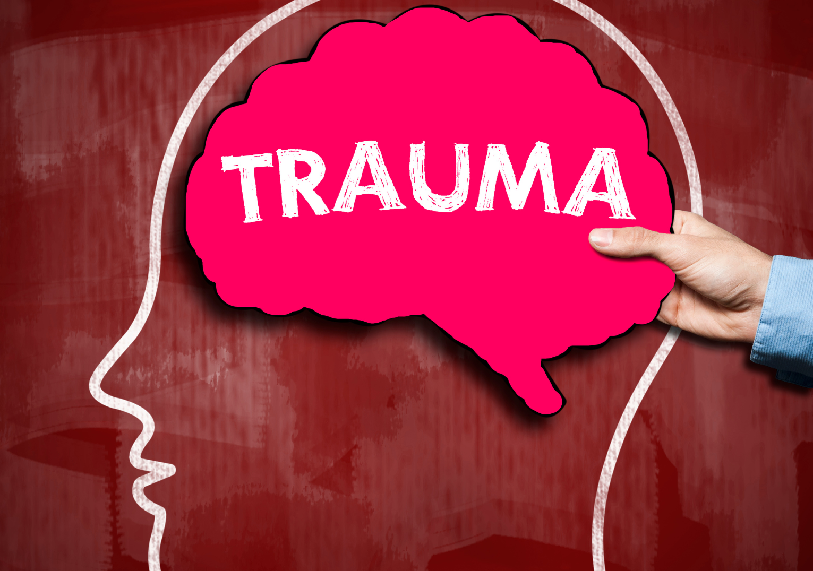

Slide 2
Trauma refers to an experience that creates a sense of fear, helplessness, or horror, and overwhelms a person’s resources for coping.
“You are having a very normal reaction to a very abnormal situation.”

Slide 3
Types of Trauma
Acute Trauma
One-time traumatic event
Fire, crime, sexual or physical assault
Chronic Trauma
Multiple traumatic events
War, domestic violence or unrelated traumas
Complex Trauma
Begins in childhood and continues or repeats for months or years at a time
Abuse, neglect, or trafficking
Secondary Trauma
Survivors’ difficulties affect family members
Trauma symptoms show up in spouses and children

Slide 4
Toxic Stress
Toxic stress refers to strong, frequent, or prolonged activation of the body’s stress management system.
The brain stays “stuck” in the crisis-alert mode.
Toxic stress can physically alter parts of the brain:
Brain chemistry changes and becomes hypersensitive.
The part of your brain that interprets and calms your emotions (hippocampus) shrinks and works less effectively.
The left and right parts of the brain have trouble communicating and balancing each other.
Toxic stress can also harm the nervous, endocrine, and immune systems, and can even alter the physical structure of DNA.

Slide 5
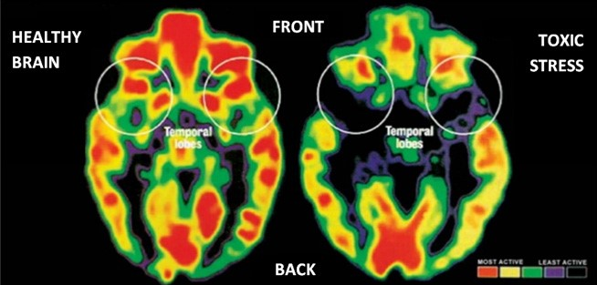
Changes to the Brain from Toxic Stress
Attention problems
Poor memory
Poor decision making
Problems with planning, organizing and sequencing information
Problems learning new things
Problems recalling old information
Anxiety
Impulsive behavior
Confusion
Unexplained pain
Problems being self-starting

Slide 6
Effects of Trauma
Fear
Powerlessness
Fear, which is the core of trauma, leads people to hide
Trauma brings with it a sense of powerlessness
They carry trauma with them into their relationships, their work, their thinking and their choices
God is viewed through the lens of trauma
Distortion
Difficulty forming healthy and stable relationships
+ Unstable work histories
Struggles with finances, family, jobs, and depression throughout life
Struggle

Slide 7
Effects of Complex Trauma
Disassociation
A coping skill used to separate the person from the traumatic events
Causes a lack of connection in a person’s thoughts and memory
Emotional dysregulation
The inability to manage the intensity and duration of negative emotions
Leads to a high degree of anxiety and frustration
Substance abuse
A maladaptive coping mechanism to dull the pain
Another way to disassociate

Slide 8
Trauma Informed Care
Focusing on WHAT HAPPENED to the person not WHAT IS WRONG with them
Emphasizes physical, psychological, and emotional safety
Creates opportunities for survivors to rebuild a sense of control and empowerment

Slide 9
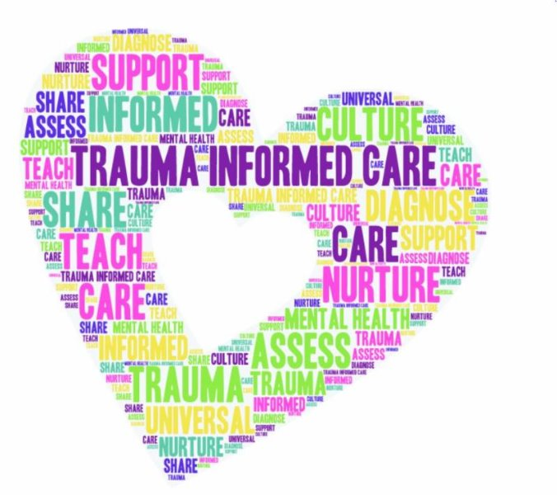
Four Themes in Trauma Informed Care
Trauma awareness
Awareness of how behaviors represent adaptations to traumatic experiences
Emphasis on safety
Works toward building physical and emotional safety for survivors
Opportunities to rebuild control
Creates predictable environments that rebuild a sense of personal control
Strengths-based approach
Survivors identify their own strengths and develop their own coping skills

Slide 10
Trauma is like a 3-number combination lock
Unlocking the problem
requires all 3 areas
Physical
Mental
Spiritual

Slide 11
The Healing Equation
SAFETY + STABILITY + SUPPORT = HEALING
TIME
Trauma REBOOT, Trauma Healing For Everyone

Slide 12
Phases of Client Services
Days 91-365
Empowerment
Development
Days 4-90
Skill Building
Crisis
72 Hours
Basic Needs
Rehabilitation
Homeless
Relief
Relief - Rehabilitation - Development Paradigm from When Helping Hurts, How to Alleviate Poverty without Hurting the Poor and Yourself.

Slide 13
Trauma Healing Course
A 12-week, faith-based course empowering people to overcome trauma and embrace a brighter future.

Slide 14
New Normal
People with trauma cannot return to “normal”
They can establish a “new normal”
This metamorphosis does not happen quickly and requires intentional work
Survivors need to build:
Relationships
Stability
Coping skills
Adaptive functioning

Slide 15
Things to Remember
Speak clearly using a calm, reassuring tone.
Be respectful.
Build relationships.
Avoid confrontation and arguing.
Model calmness.
Show, not tell, if at all possible.
Be specific and limit instructions.
Break down information into smaller parts.
Provide tools to help the person.
Make sure your non-verbal and verbal messages agree.

